Slide 1
ITP4913M FYP Interim Present
Group: Edward Ma 9 Supervisor: Mr. Ma Siu Kwong, Edward Co-Marker: Ms. Yuen Oi Sheung, Ada
Students:
Wong Ming Yuen, Siu Chi Wang,
Kwok Tsz Lung, Chau Yat Sum

Slide 2
Presentation Outline
Objectives
Problem Background
Project Outline
Function Provided
Client Side
Server Side
High-level Analysis
Use Case Diagram
Sequence Diagram
Summary of Finished Progress
Notes:
This is our presentation outline. We will first talk about the objectives and the reasons why we create this system. Then, we will talk about the function provided by client side and Server side.

Slide 3
Objective
Main objective
Provide visualized climatic data from UAV
Multi-platform
Android App
Windows App
UAV
Cheap and easy maintain

Slide 4
Problem Background
Large amount of exhaust emission is released because of industry high-speed development
Harmful to human's health
Observatory cannot provide accurate data for every region
Some places human cannot arrive easily
Disaster area
Mountain
Notes:
The reasons that made us create this system because nowadays there is large amount of exhaust emission released due to industry high-speed development, which is harful to human's health. Besides that, observatory cannot provide accurate data for every region. Also, some places human cannot arrive easily, like disaster area or mountain etc.

Slide 5
Project Outline
UAV
Window Application
Android Application
Notes:
We can connect the UAV through different platforms, Android App and Windows App.

Slide 6
Functions Provided
We can connect to the UAV through different platforms.
Android app:
Display real-time view from UAV
Control UAV
Display location of UAV on map
Display details of UAV
Take photo or video during live streaming
Notes:
For android app, we can control the UAV to fly, view the live stream and take photo or video during live stream. There is a map that can show us the location of the UAV. We can also look at different climatic datas collected by the UAV. Besides, we can also take photos or videos during live streaming.

Slide 7
Functions Provided
Windows app:
Data Collection
Display real-time view from UAV
Display location of UAV on map
Display details of UAV
Build up new mission
Generate graphs instantly when climatic data is received
Notes:
For Windows app, we can collect data and view live streaming form UAV. Besides, we can view the details of UAV and build up new mission. Other than that, graphs will be instantly generated when climatic data is received.

Slide 8
Functions Provided
UAV:
Provide visualized climatic data to user
Temperature
Humidity
UV Level
PM2.5
Allow live stream
Notes:
As for the UAV, it can provide visualized climatic data to user and allow live stream.

Slide 9
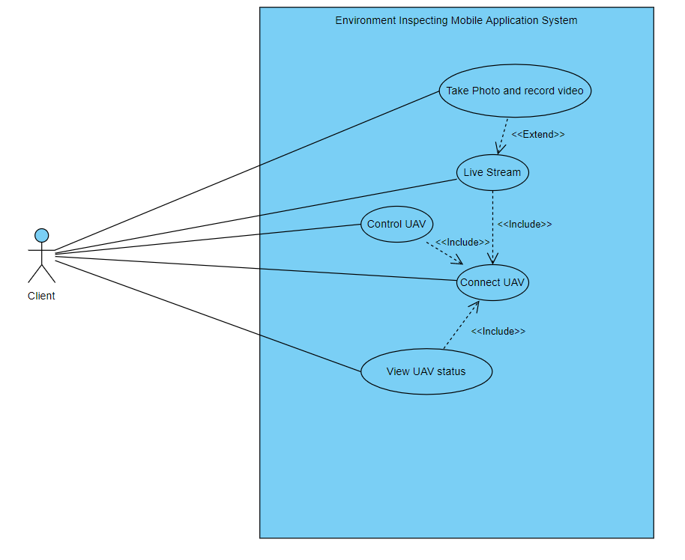
Use Case of Mobile App
Notes:
Here's our use case diagram of mobile app.

Slide 10
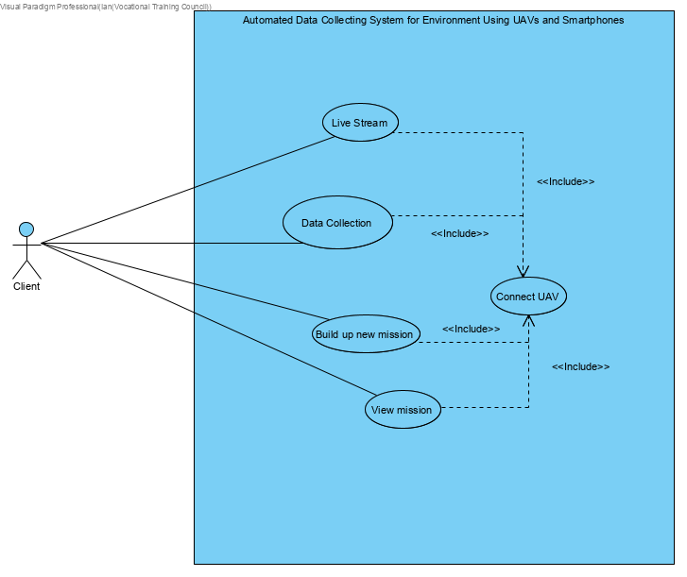
Use Case of Windows App

Slide 11
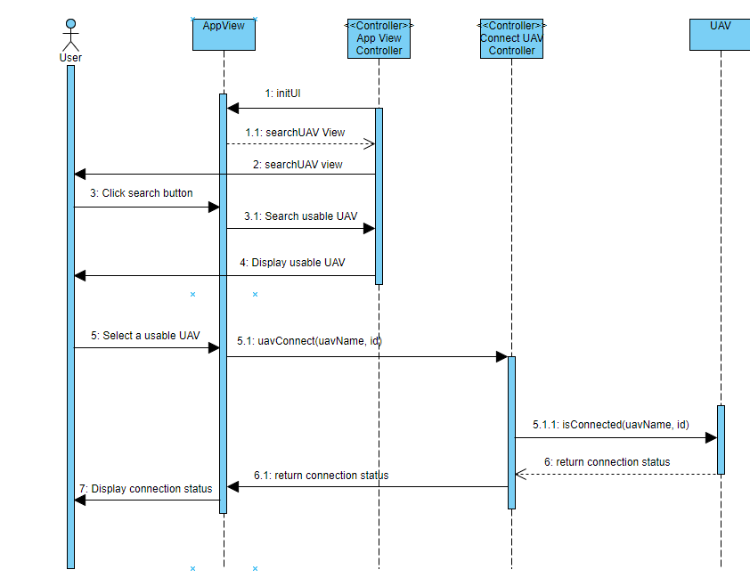
Sequence Diagram of Android App(Connect UAV)

Slide 12
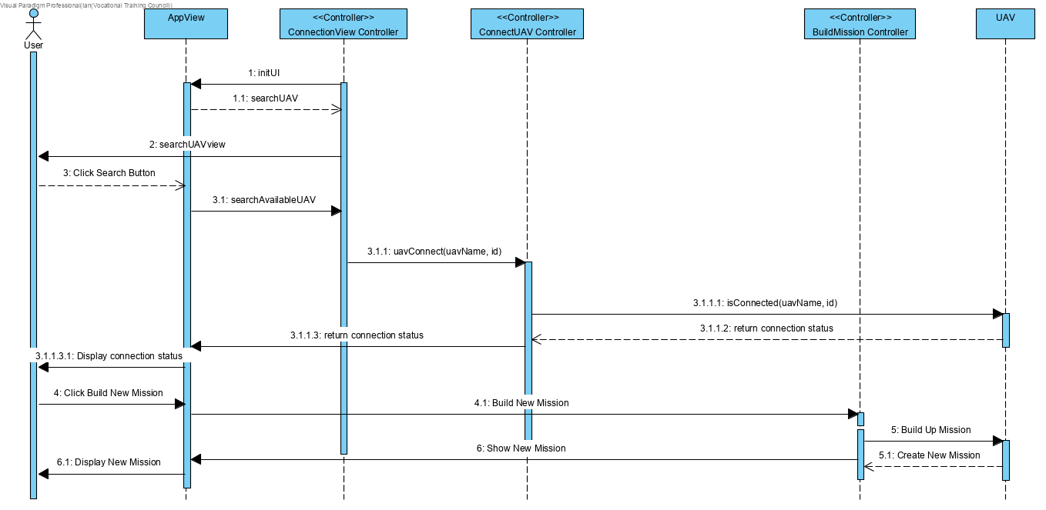
Sequence Diagram of Windows App (Build New Mission)

Slide 13
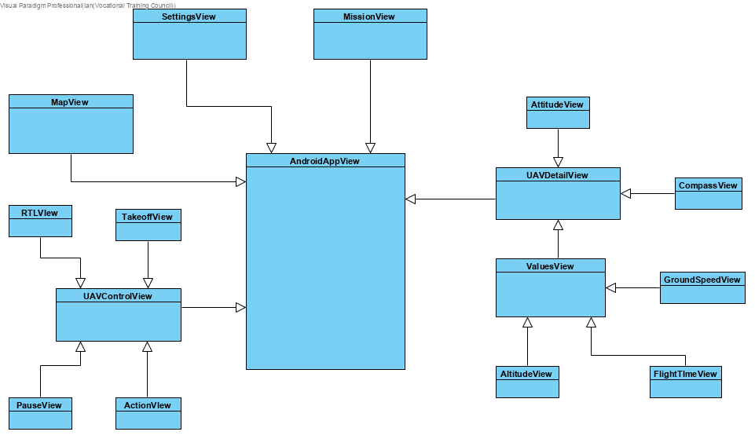
Class Diagram of Android App

Slide 14
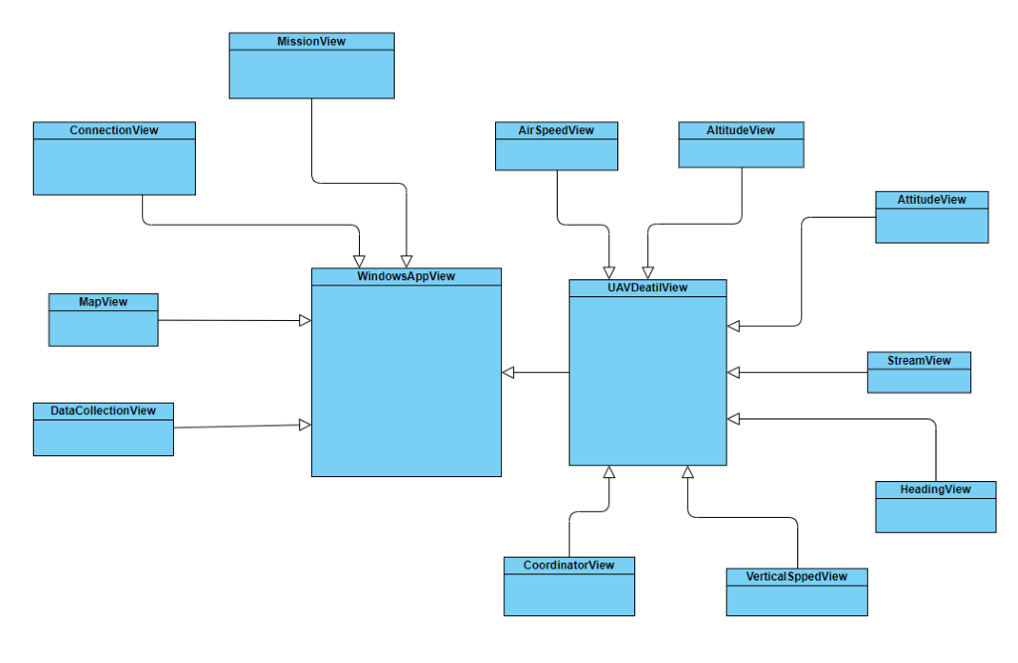
Class Diagram of Windows App

Slide 15
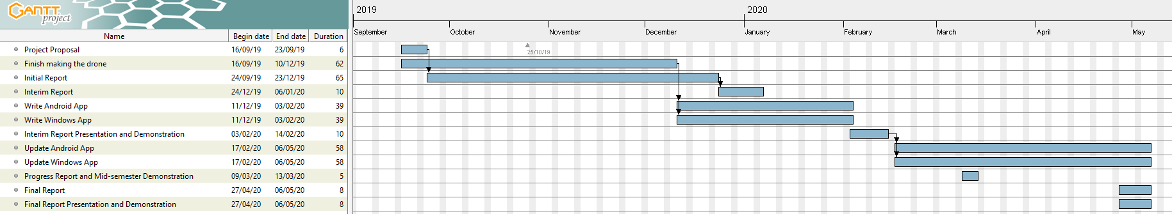
Project Schedule
Notes:
This is our project schedule.

Slide 16
Critical Environment
Network stability
Battery capacity limitation
Fire risk with LiPi battery
Weather problem(e.g. strong wind)
Start from zero
Notes:
For the critical environment, first of all we worried about the network stability, as the network connection sometimes is too slow. Then is the battery capacity limitation. Under our calculation, the battery we used will provide 21.6 minutes of flight times. Next, is the fire risk with LiPi battery. We use Lithium Polymer technology which allows considerable energy to be stored in a small package. However, they are related to fire risk and have been known to catch fire spontaneously while charging or if punctured. After that, will be the weather problem. We do not recommend users to fly drones in rainny, snowy days or even in the drizzle because not only the aircraft may take some physical effects, but also the electronics may take damages.

Slide 17
Summary of Finished Process
Mobile app:
Display real-time view from UAV
Control UAV
Display location of UAV on map
Display details of UAV
Take photo or video during live streaming
UAV:
Collect visualized climatic data
Windows app:
Build up new mission
Data collection
Display real-time view from UAV
Display location of UAV on map
Display details of UAV
Analyze climatic data
Notes:
Last, we are going to sum up our presentation. For mobile app, we can view live streaming from UAV when controlling the UAV. We can photos or videos can be taken during live streaming. For Windows app,we can build up a new mission. We can also check the data collected by the UAV. Besides that, it can analyze climatic data. Live streaming, location of UAV on map and details of UAV can be done on both mobile and Windows app.
As for UAV, visualized climatic data will be collected.

Slide 18
End Of Presentation

